Slide 1
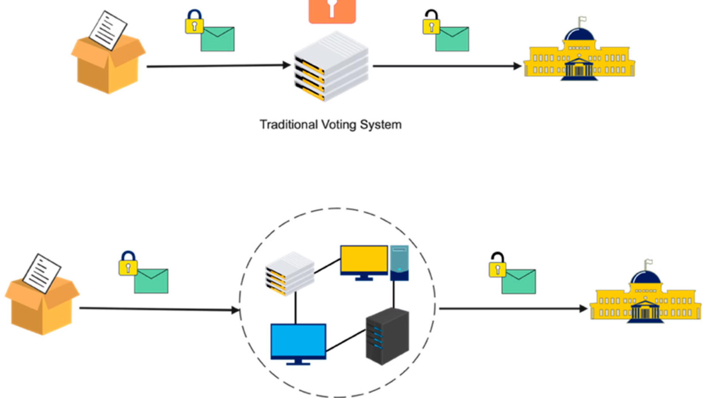
Blockchain for Voting System: Securing
Democracy in South Asia
Monirul I. Mahmud

Slide 2
Motivation
How blockchain technology can revolutionize voting systems, addressing existing critical vulnerabilities?
We'll delve into the challenges of current systems, real-world examples of voting, and the innovative blockchain solutions that can secure the democratic process.
Discover how this technology can restore public trust and ensure fair elections.

Slide 3


Existing Voting Systems in South Asia
Paper Voting
Electronic Voting (EVM)
Slower as Voter marks a paper ballot manually.
Takes hours or days due to manual counting.
Costly (needs printing, storage, manpower).
Security Issues –
Fraudsters can add fake ballots to the box.
Manual counting is prone to errors or manipulation.
Lack of Audit Trail (in absence of CCTV).
Faster as Voter presses a button on a machine to cast vote
Results in a few hours via automated counting.
Less Costly long-term operation.
Security Issues –
Hardware Tampering – Vote can be manipulated (EPIC Universal Memory Card Emulator, Arduino, Oscilloscopes).
Embedded code may be manipulated if not securely programmed.
Machines require secure storage before and after elections.
Absence of Internet = No Hacking but also No Audit Trail

Slide 4
Real world incidents of Voting Frauds in South Asia

Slide 5
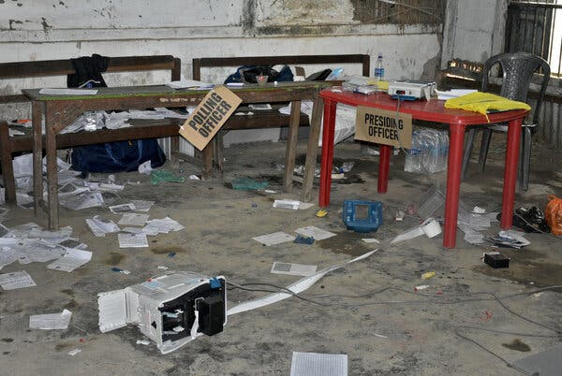
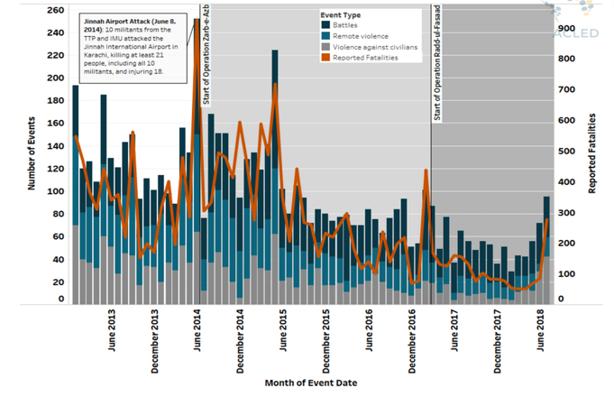

Vote-Buying and Electoral Violence
INDIA:
During the 2019 general elections, parties distributed cash, alcohol, and gifts to influence voters in states like Tamil Nadu and Andhra Pradesh [1].
Armed groups in West Bengal and Bihar have hijacked polling stations to stuff ballots or intimidate voters [2].
PAKISTAN:
Karachi Clashes: Political rivalries (MQM vs. PPP) have led to deadly violence during elections, discouraging voter turnout. [6]
Ghost Voting: 2018 elections exposed fake voter IDs and votes cast in the names of deceased citizens.
Over 40% of public service users report paying bribes, affecting electoral fairness.
Fig 1 : Damaged station highlights India's election challenges.
Fig 2: Political Violence by Type and Reported Fatalities in PK

Slide 6
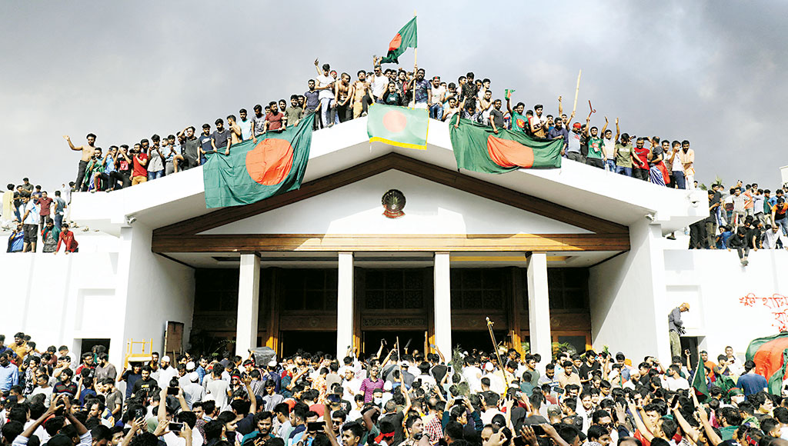
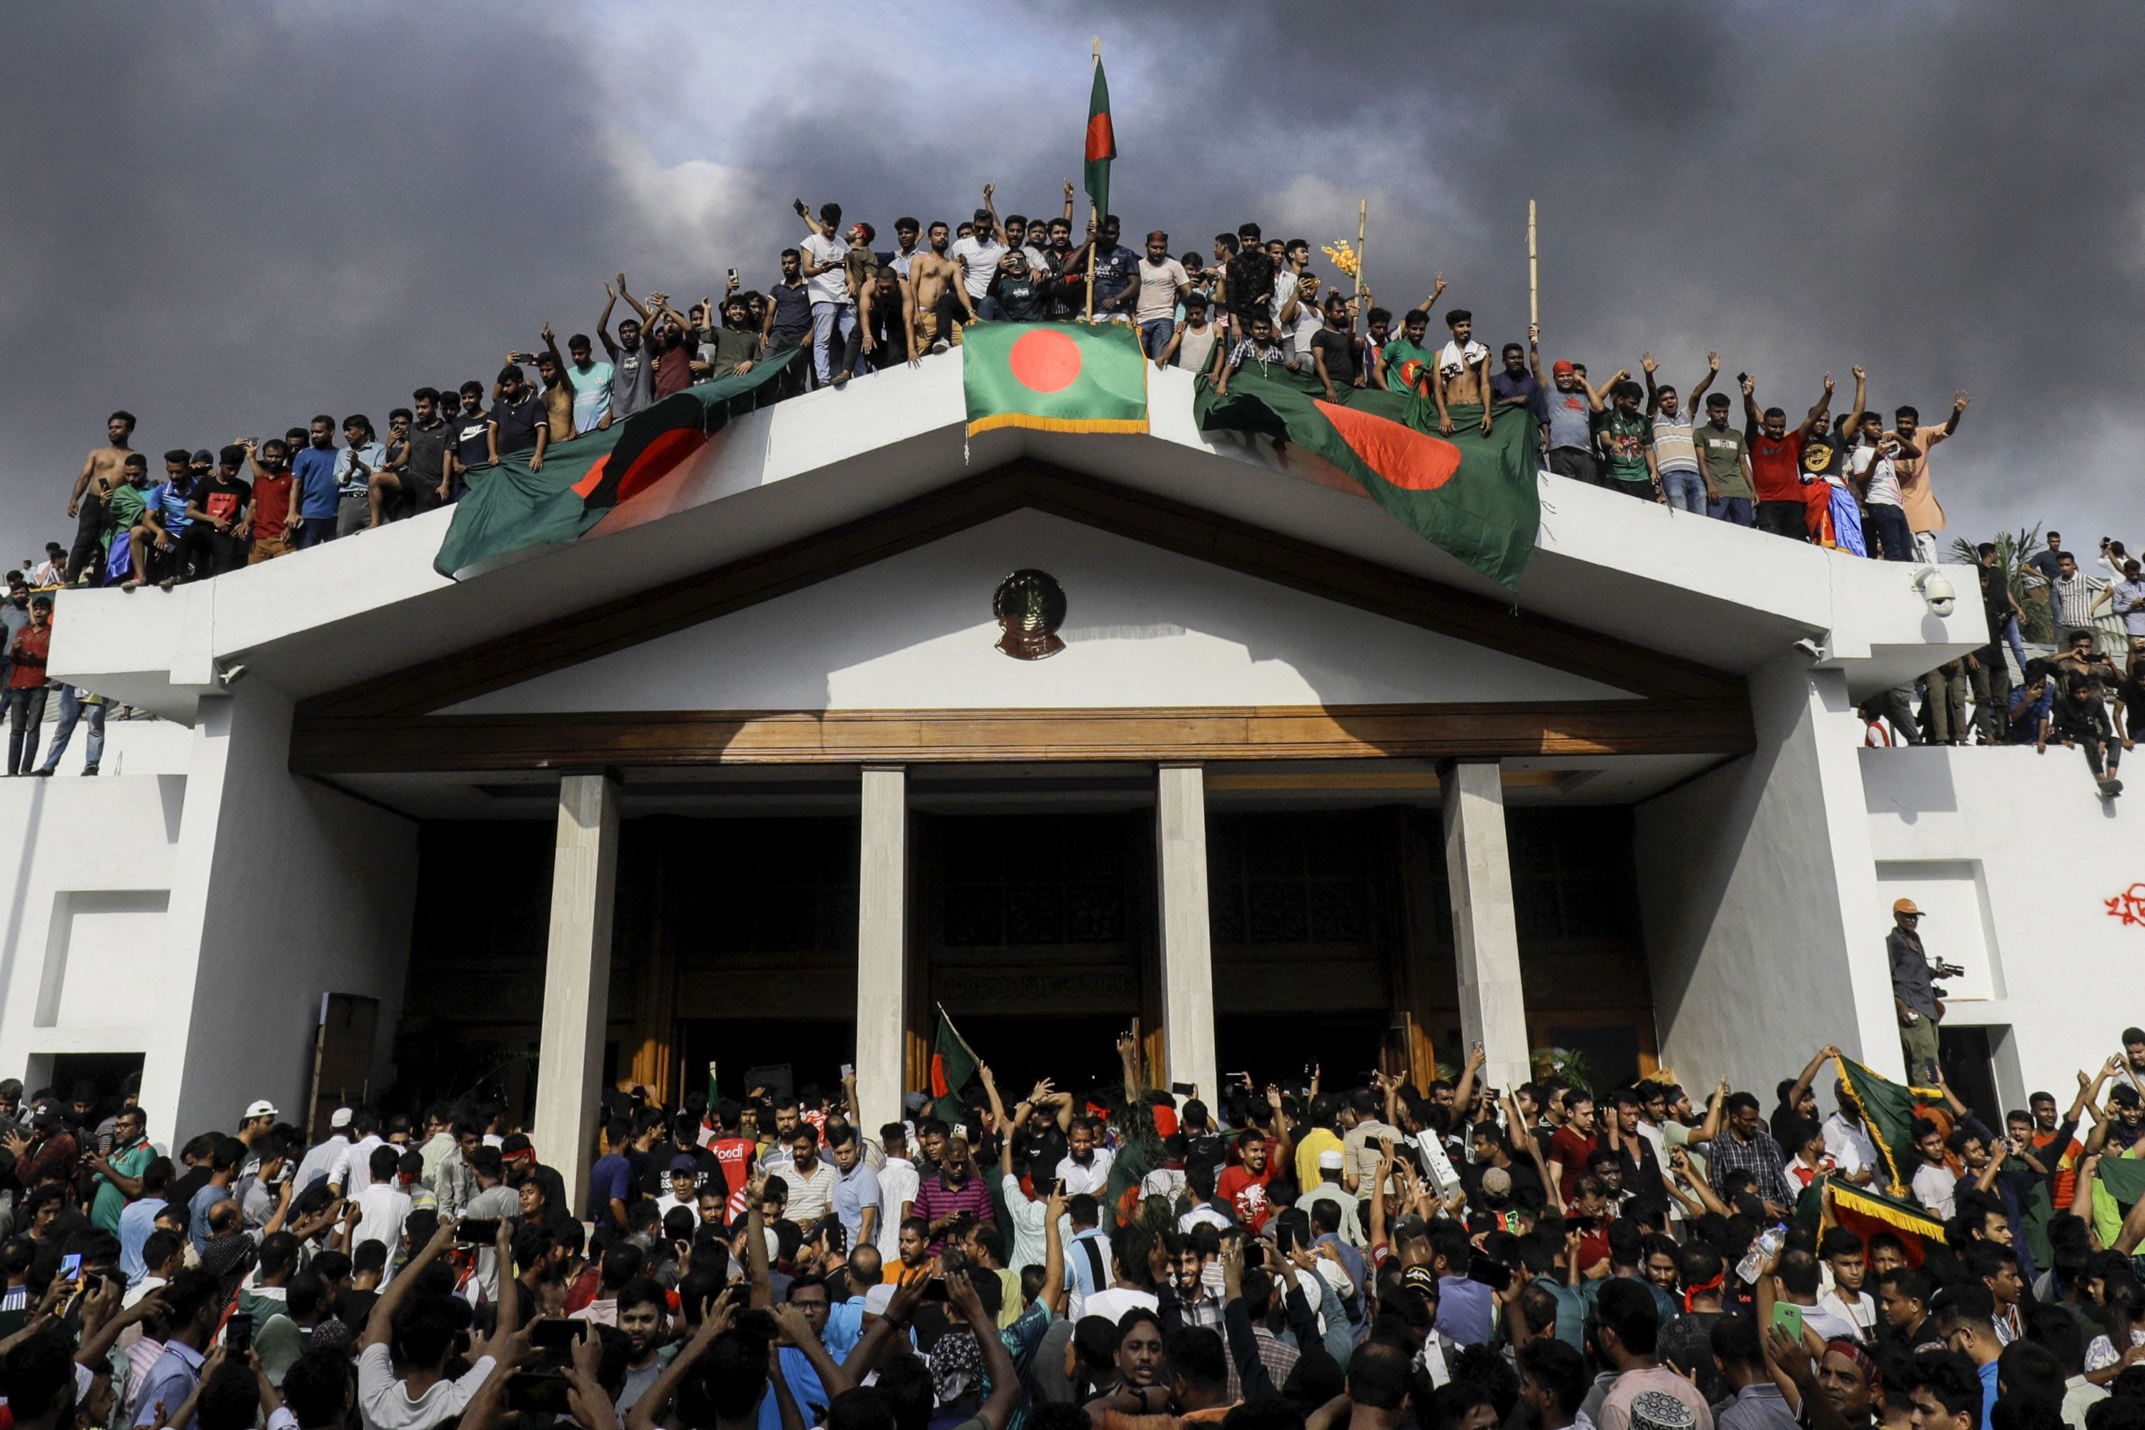
Vote Rigging and Political Clashes in Bangladesh
Bangladesh experiences vote rigging and political clashes, with allegations of ballot stuffing and voter suppression.
2008–2024 Elections: Allegations of vote rigging and ruling party intimidation led to deadly violence and opposition boycotts (1400 killed). [5]
Rohingya refugees, immigrants living abroad, and stateless people often excluded due to lack of documentation.
Mass protests forced former Autocrat PM Sheikh Hasina to flee; facing allegations of corruption and human rights violations (JULY REVOLUTION).
Figure 3: July Revolution of Bangladesh (5 Aug 2024)

Slide 7


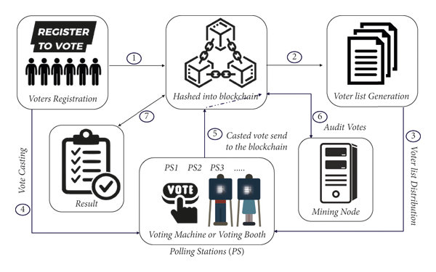



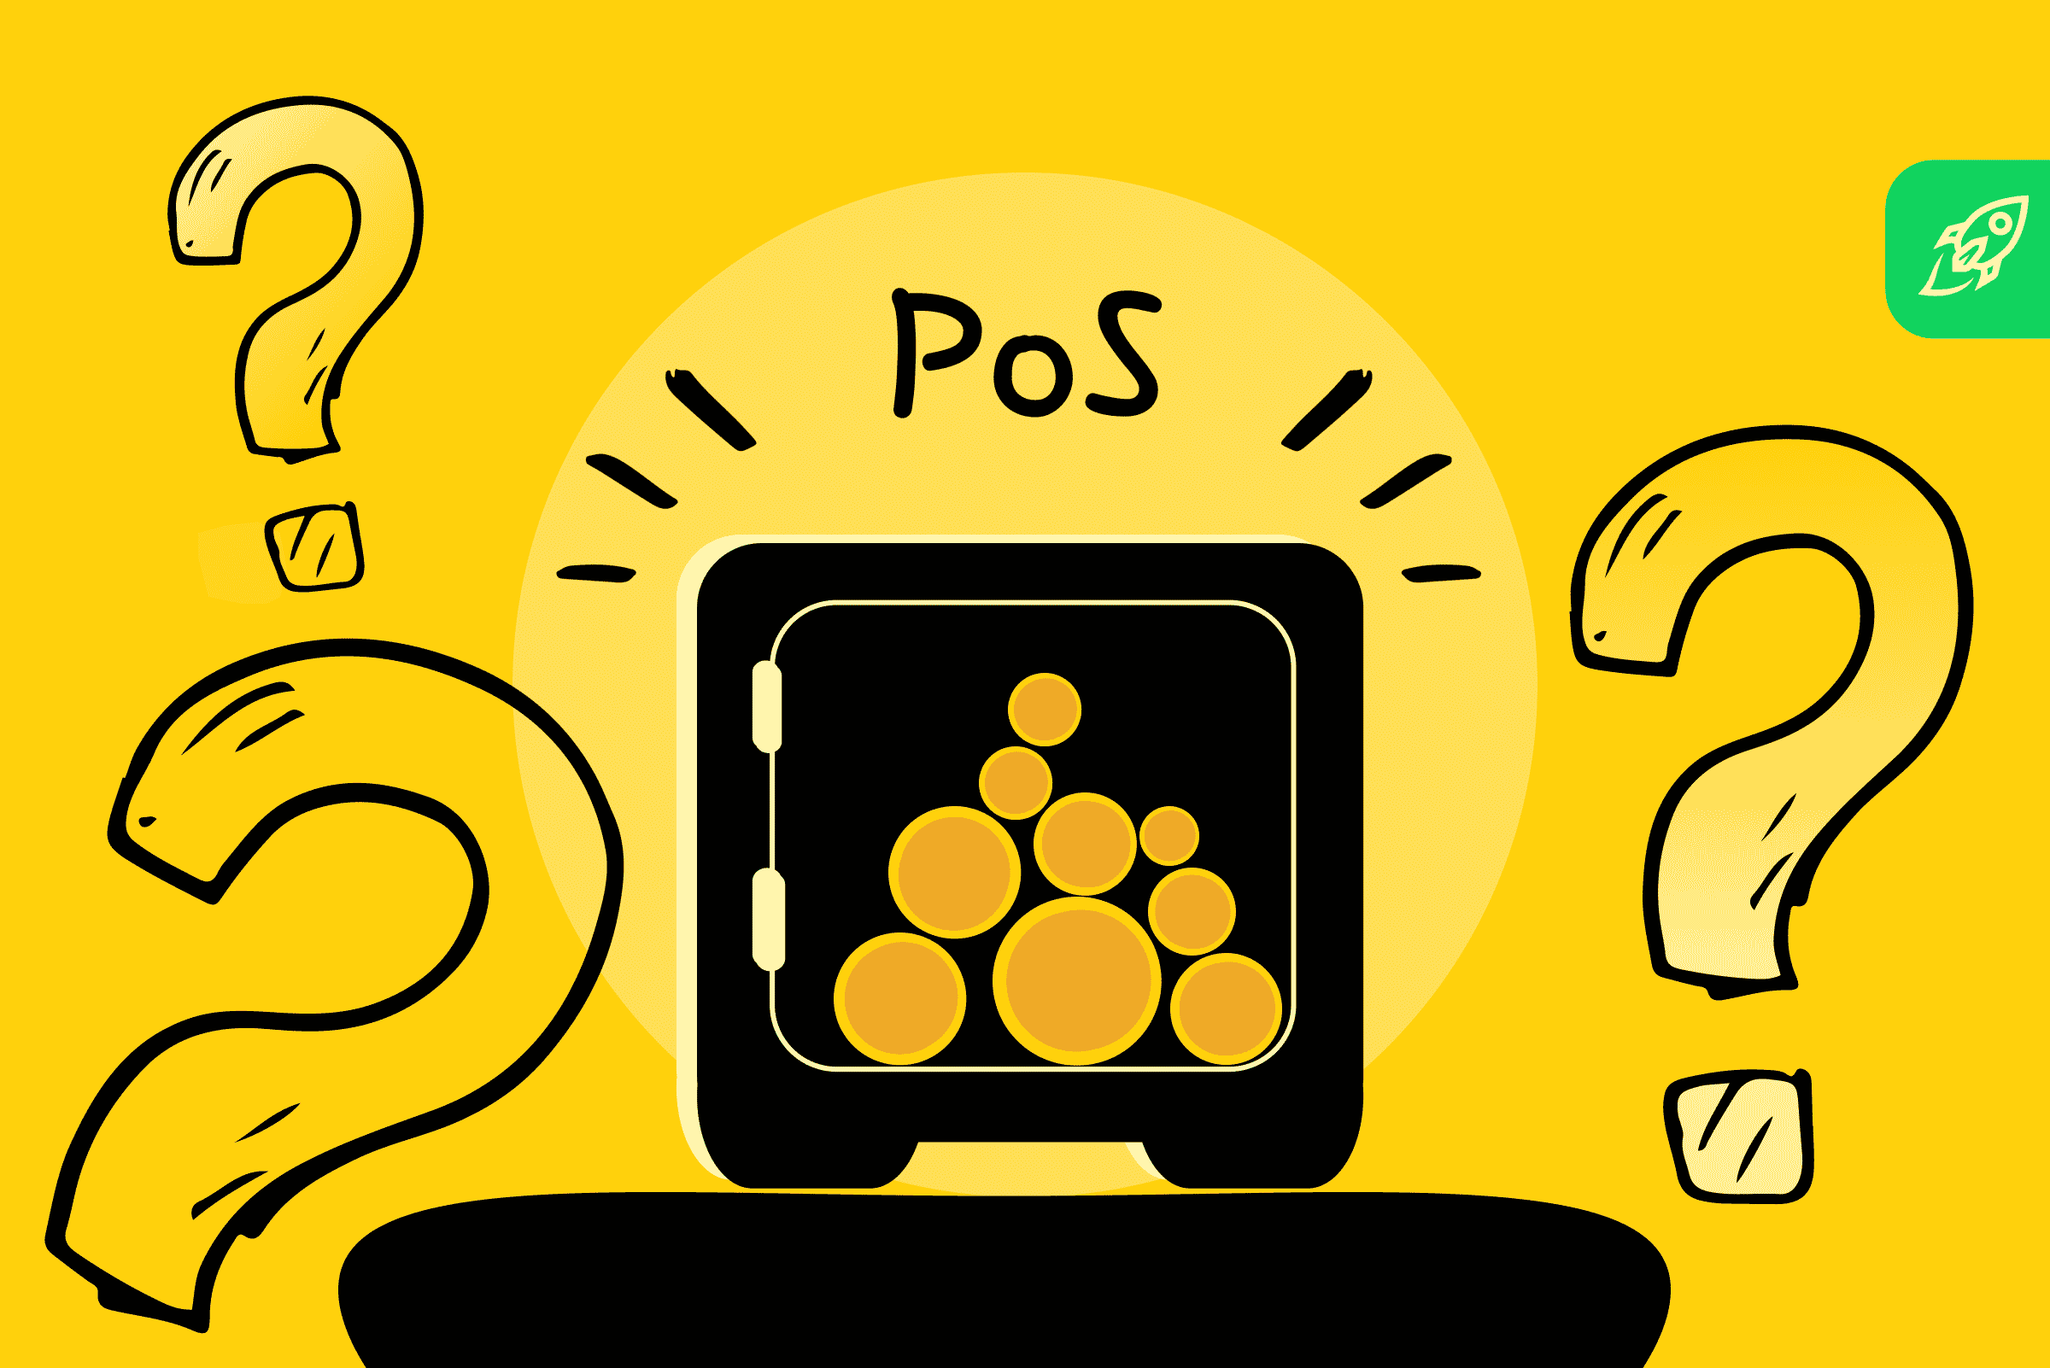


How Blockchain Can Be Applied to Voting Machines
Secure Registration & Authentication
Utilize DID (Decentralized Identity) for secure registration and MFA/Biometrics for voter verification.
Private & Valid Voting
Employ ZKPs for voter privacy and Smart Contracts to enforce rules like one-vote-per-person
Tamper-Proof Vote Records
Cryptographically hash and store votes immutably on the blockchain ledger.
Automated & Private Counting
Leverage Smart Contracts for real-time counting, potentially with Homomorphic Encryption
Figure 4:Flowchart of a blockchain-based voting system process.
Full Transparency & Auditability
Allow public verification and auditing of votes/counts via the accessible blockchain ledger.
Verified Results & Dispute Resolution
Derive final results directly from the secure ledger and use Smart Contracts for transparent disputes.
Notes:
Decentralized Identity (DID), Zero-Knowledge Proofs (ZKPs) - allow voters to prove they are eligible, and their vote is legitimate.

Slide 8
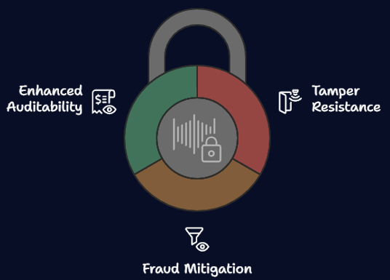




Security Benefits of Blockchain Voting
Tamper Resistance
Fraud Mitigation
Enhanced Auditability
Blockchain's immutability prevents unauthorized access to vote data.
Consensus mechanisms ensure only valid votes are recorded.
A publicly auditable record allows for independent verification of election results.

Slide 9
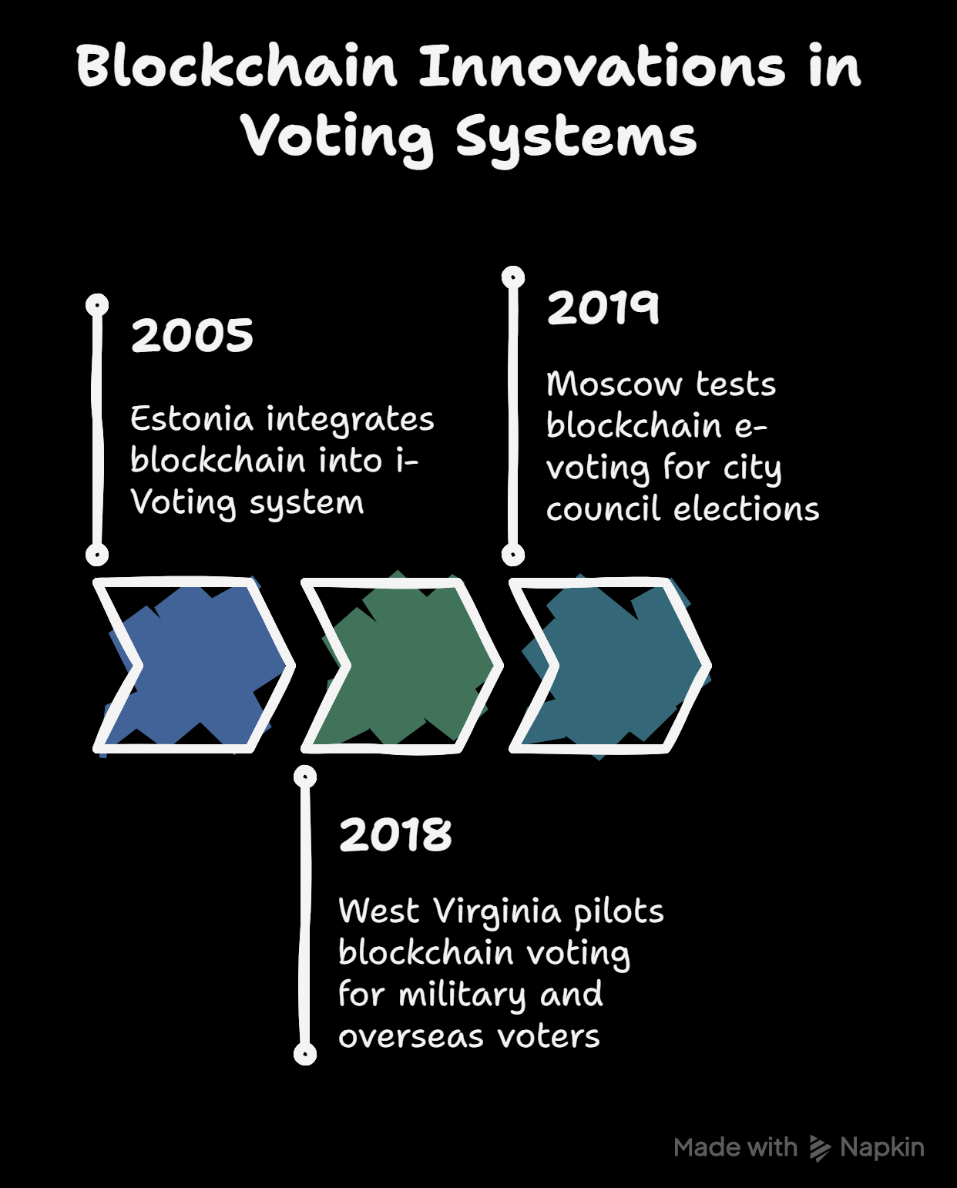
Real-World Blockchain based Voting Examples
West Virginia, USA (2018) – Used Voatz blockchain for military/overseas voting, praised for convenience but criticized for security risks. [7]
Estonia – Blockchain-backed i-Voting since 2005, with 50%+ online votes but debated cybersecurity resilience. [8]
Moscow, Russia (2019) – Ethereum-based e-voting pilot for city elections, questioned over transparency and centralization. [9]
Figure 6: Blockchain based election examples.

Slide 10



Conclusion: A Paradigm Shift in Elections?
Trust
Enhanced voter trust
Transparency
Open election results
Security
Resistant to fraud

Slide 11
Q&A and Discussion
Discussion 1 : Are there any security concerns with implementing blockchain in voting systems?
Discussion 2: Can all South Asian countries implement blockchain-based voting, considering socio-economic situation?

Slide 12
Q&A and Discussion
Discussion 1 : Are there any security concerns with implementing blockchain in voting systems?
Answer: Yes, there are some security concerns. Even though blockchain is secure, issues can arise from Huge Population, weak devices, poor internet security, or poorly written smart contracts. There’s also a risk if biometric data like fingerprints are not stored safely. Sybil Attacks, and DOS attack issues. To handle these risks, strong cybersecurity, data encryption, system testing, and regular audits are needed to keep the voting process safe.
Discussion 2: Can all South Asian countries implement blockchain-based voting, considering socio-economic situation?

Slide 13
Q&A and Discussion
Discussion 1 : Are there any security concerns with implementing blockchain in voting systems?
Answer: Yes, there are some security concerns. Even though blockchain is secure, issues can arise from Huge Population, weak devices, poor internet security, or poorly written smart contracts. There’s also a risk if biometric data like fingerprints are not stored safely. Sybil Attacks, and DOS attack issues. To handle these risks, strong cybersecurity, data encryption, system testing, and regular audits are needed to keep the voting process safe.
Discussion 2: Can all South Asian countries implement blockchain-based voting, considering socio-economic situation?
Answer: Not all South Asian countries are equally ready. While countries like India may have the resources and digital infrastructure, others may face issues like low internet access, poor digital skills, and lack of trust in technology. Still, with step-by-step implementation, pilot programs, and public awareness, it’s possible to gradually introduce blockchain voting in the region.

Slide 14
References
India: Alleged Vote Rigging in Elections - Debnath, S., Kapoor, M., & Ravi, S. (2016).
Javid, H. (2019). Special issue: Electoral fraud and manipulation in India and Pakistan. Taylor & Francis.
Human Rights Watch. (2019, January 2). Bangladesh: Election Abuses Need Independent Probe.
Al Jazeera. (2018, December 31). Bangladesh election makes mockery of democracy: BNP’s Alamgir.
https://www.reuters.com/world/asia-pacific/around-1500-killed-bangladesh-protests-that-ousted-pm-hasina-2024-11-17/
https://www.crisisgroup.org/asia/south-asia/pakistan/345-disputed-polls-and-political-furies-handling-pakistans-deadlock
https://slate.com/technology/2019/07/west-virginia-blockchain-voting-voatz.html
https://www.researchgate.net/publication/383583099_Blockchain-Based_Electronic_Voting_Lessons_from_Estonia
https://www.coindesk.com/markets/2019/08/16/moscow-blockchain-voting-system-completely-insecure-says-researcher

Slide 15
Thank You

